Slide 1
Data Visualization in R
Seattle R User Meetup
August 23, 2018
Ellis Hughes & Gagandeep Singh

Slide 2

Ellis Hughes
Statistical Genetics Progammer at Axio Research
Programming for 6 years
Connect with Me:
linkedin.com/in/ellishughes
@ellis_hughes

Slide 3

Gagandeep Singh
Data Scientist at ProCogia
UW Masters in Data Science
Programming for 6 years
Connect with Me:
linkedin.com/in/gagandeeepuw/

Slide 4
What’s the big Deal?

Slide 5
My Fantastic Analysis
As you can see, when we increase Var1, the Outcome increases proportionally
Outcome | Var1 | Var2 | Var3
93.4454 | 20 | 0.957056 | 3
276.1394 | 88 | 1.782812 | 1
307.1479 | 94 | 2.144952 | 2
157.7836 | 48 | 3.152969 | 1
75.27681 | 10 | 4.243559 | 3
176.6948 | 46 | 2.415217 | 3
180.7175 | 47 | 2.699317 | 3
208.8854 | 62 | 1.202246 | 2
201.0149 | 59 | 1.67286 | 2
52.59472 | 12 | 5.495602 | 1
66.78848 | 11 | 5.7452 | 2
279.0056 | 78 | 4.168222 | 3
90.77577 | 18 | 1.882159 | 3
93.95464 | 27 | 2.462196 | 1
249.0254 | 71 | 1.673733 | 3
169.039 | 43 | 2.788601 | 3
202.6974 | 58 | 3.623913 | 2
190.5917 | 59 | 2.993114 | 1
 | Outcome | Var1 | Var2 | Var3
Min. | 52.59472 | 10 | 0.957056 | 1
1st Qu. | 92.77799 | 19.5 | 1.755542 | 1
Median | 178.7062 | 47.5 | 2.580757 | 2
Mean | 170.6432 | 47.27778 | 2.839096 | 2.166667
3rd Qu. | 218.9204 | 64.25 | 3.75999 | 3
Max. | 307.1479 | 94 | 5.7452 | 3
R² | Outcome | Var1 | Var2 | Var3
Outcome | 1 | 0.989517 | -0.40192 | 0.027203
Var1 | 0.989517 | 1 | -0.41124 | -0.11088
Var2 | -0.40192 | -0.41124 | 1 | -0.17943
Var3 | 0.027203 | -0.11088 | -0.17943 | 1

Slide 6
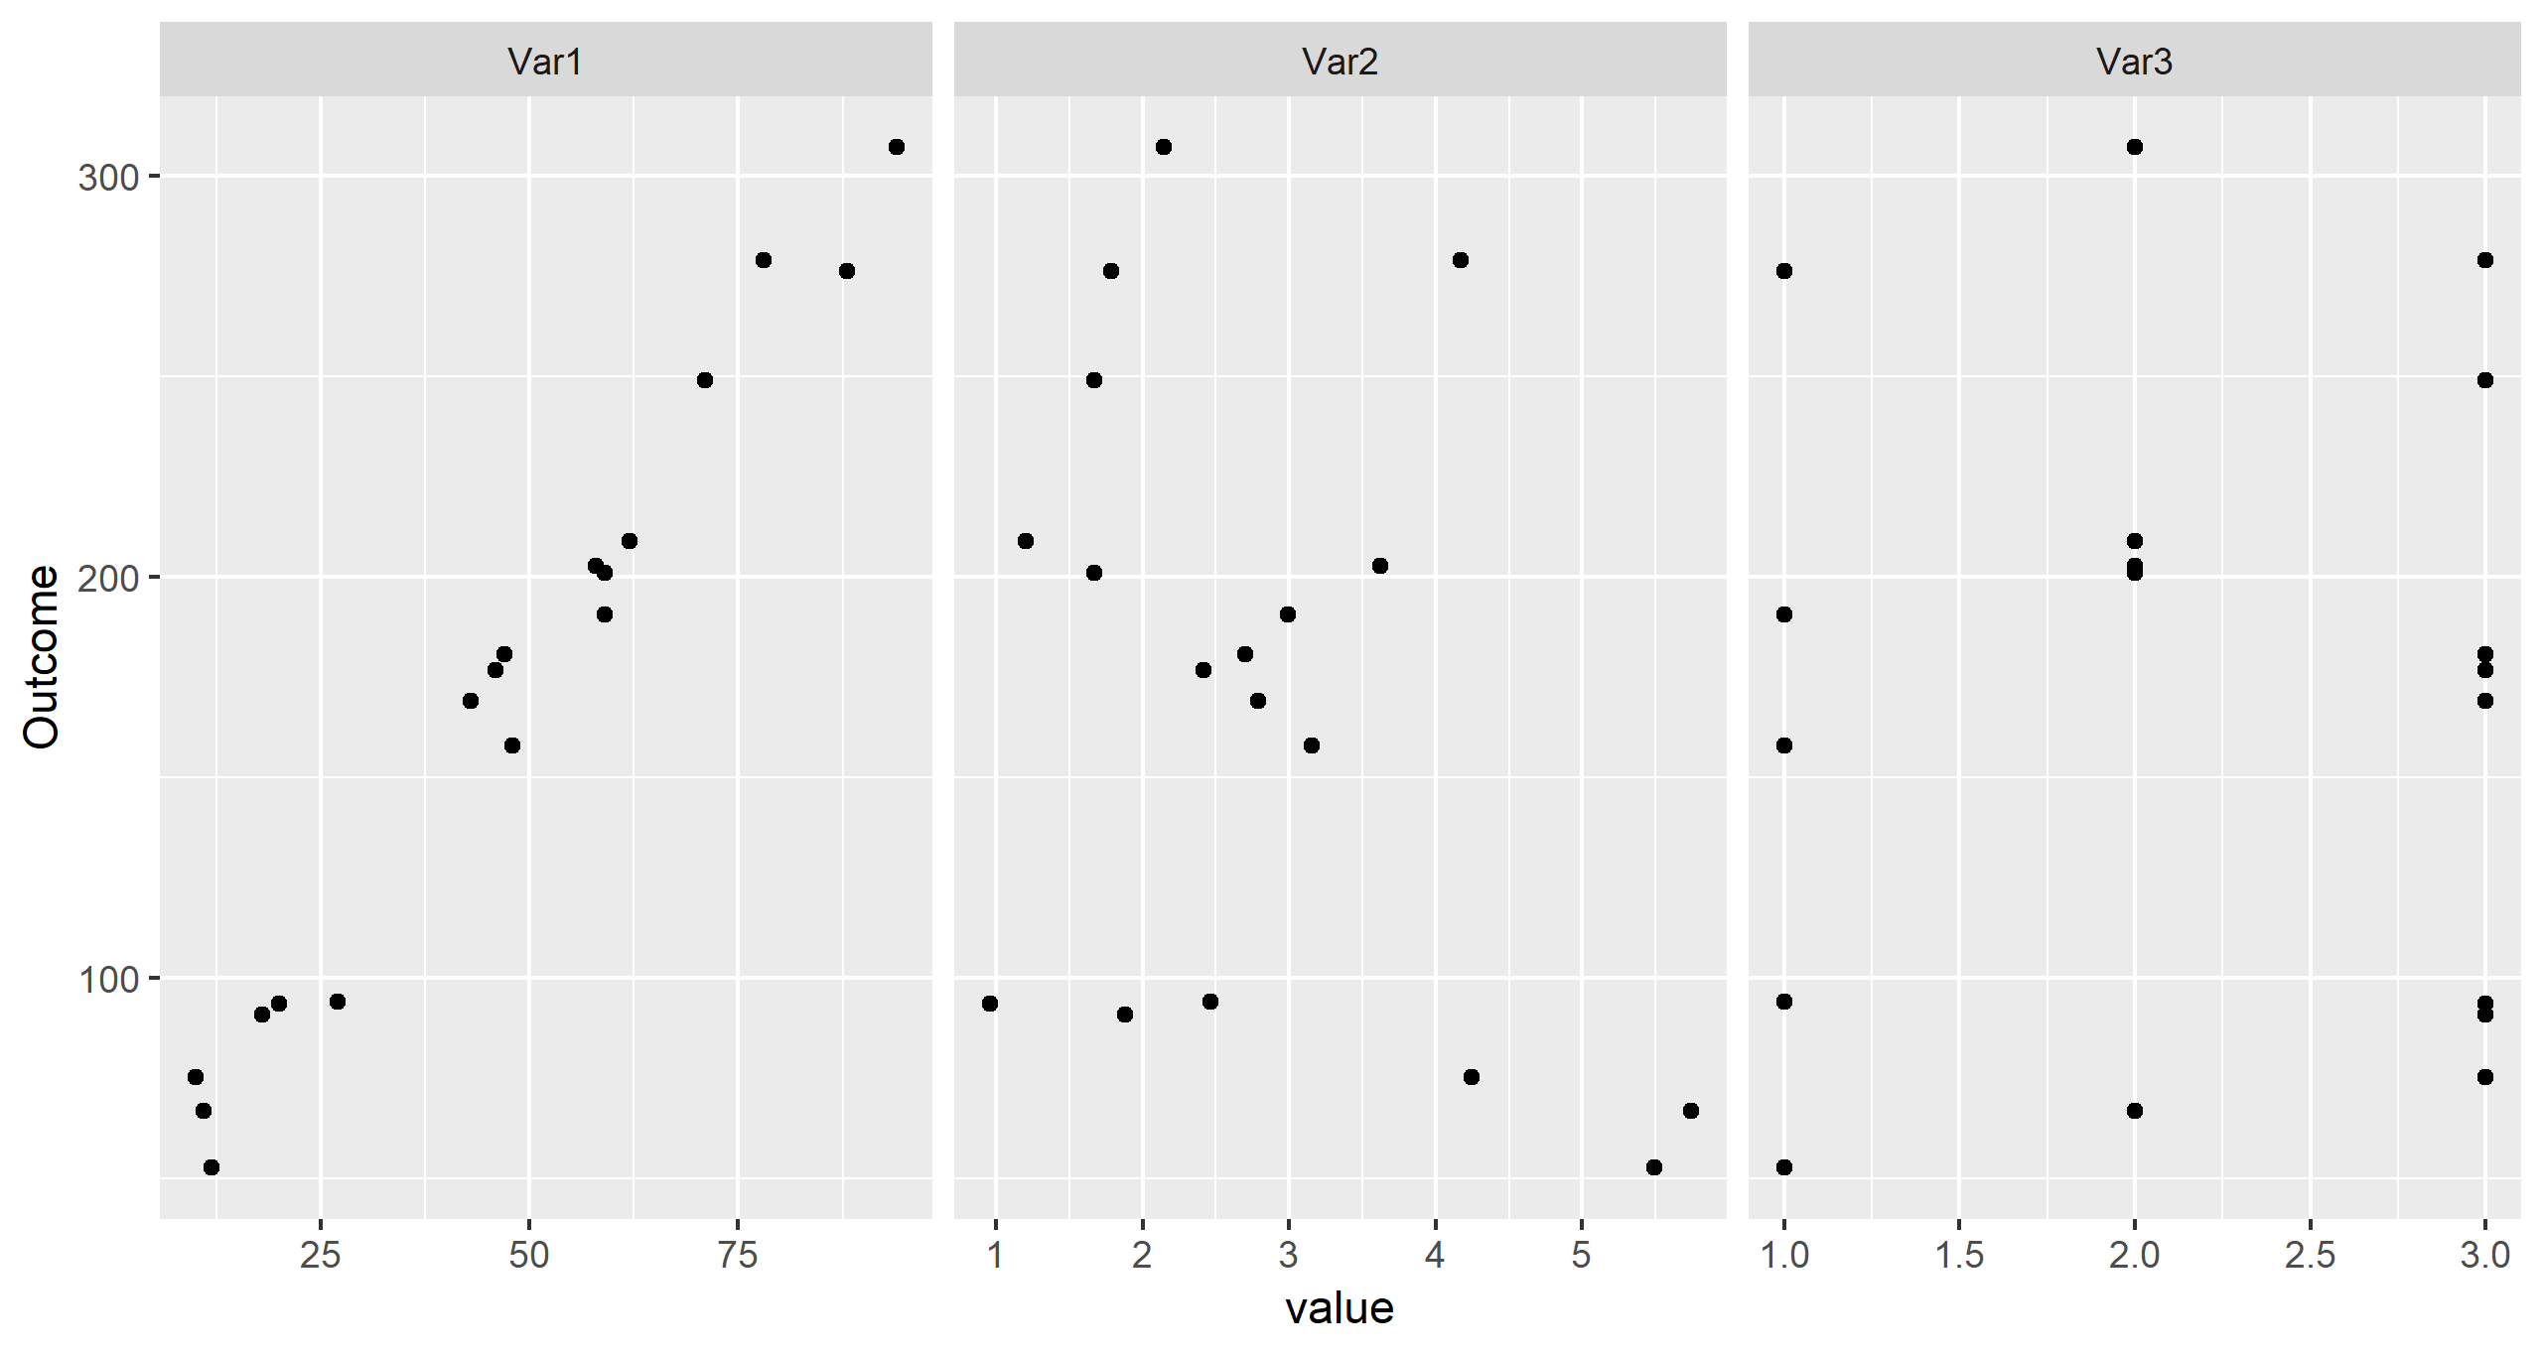
My Fantastic Analysis
As you can see, when we increase Var1, the Outcome increases proportionally

Slide 7
Graphics are for telling a story
You are the expert
Presentations are for exchanging information
Graphics convey the idea

Slide 8
The Right fit
Many different plot types:
Scatter, bar, line, box, heatmap

Slide 9
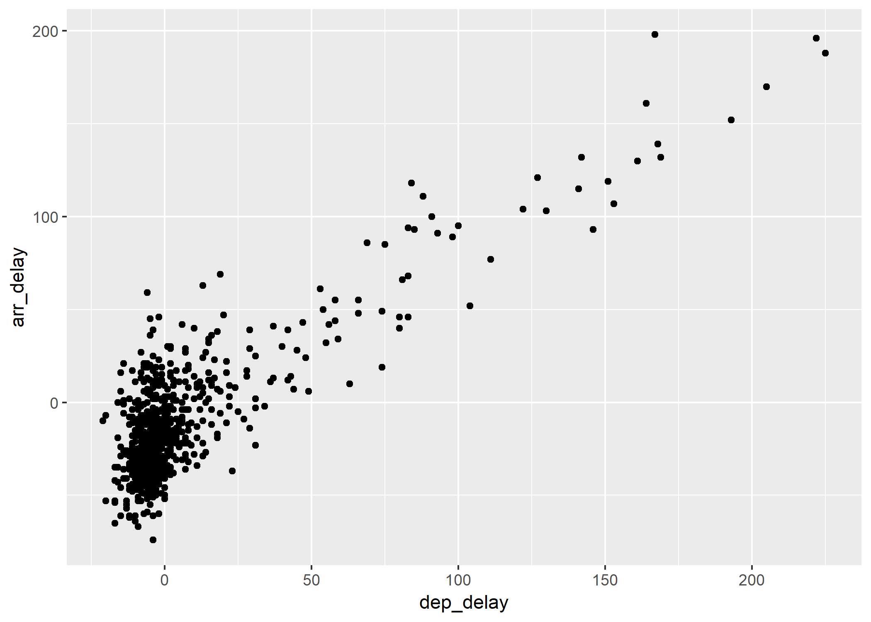
The Scatter

Slide 10
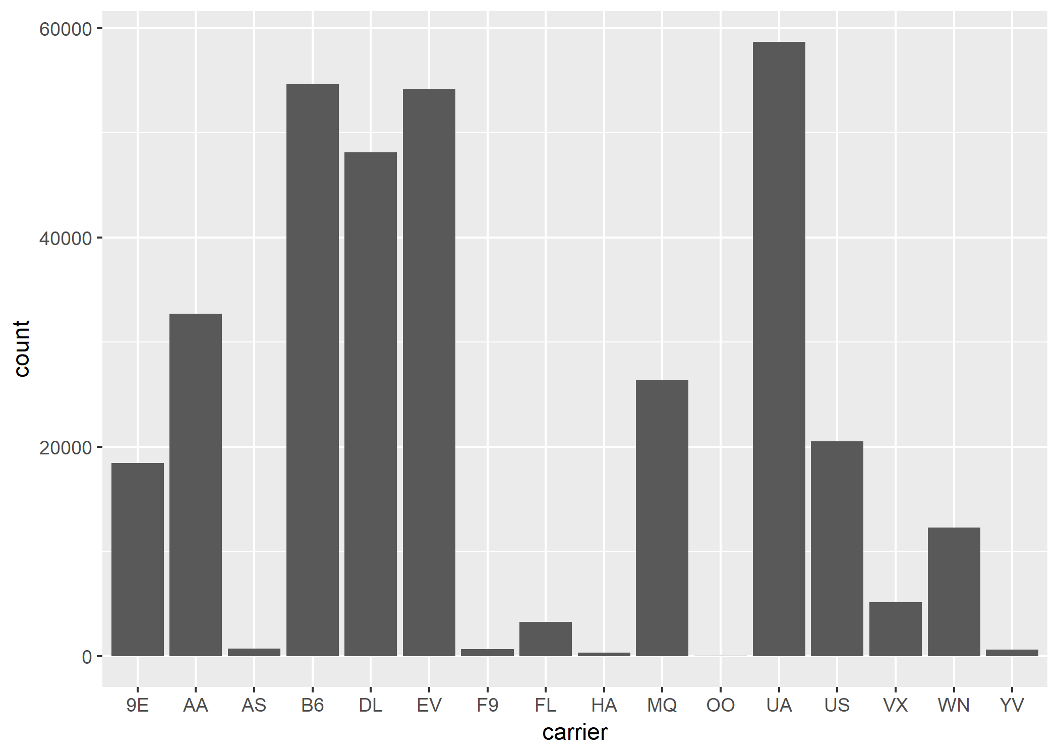
The Bar

Slide 11
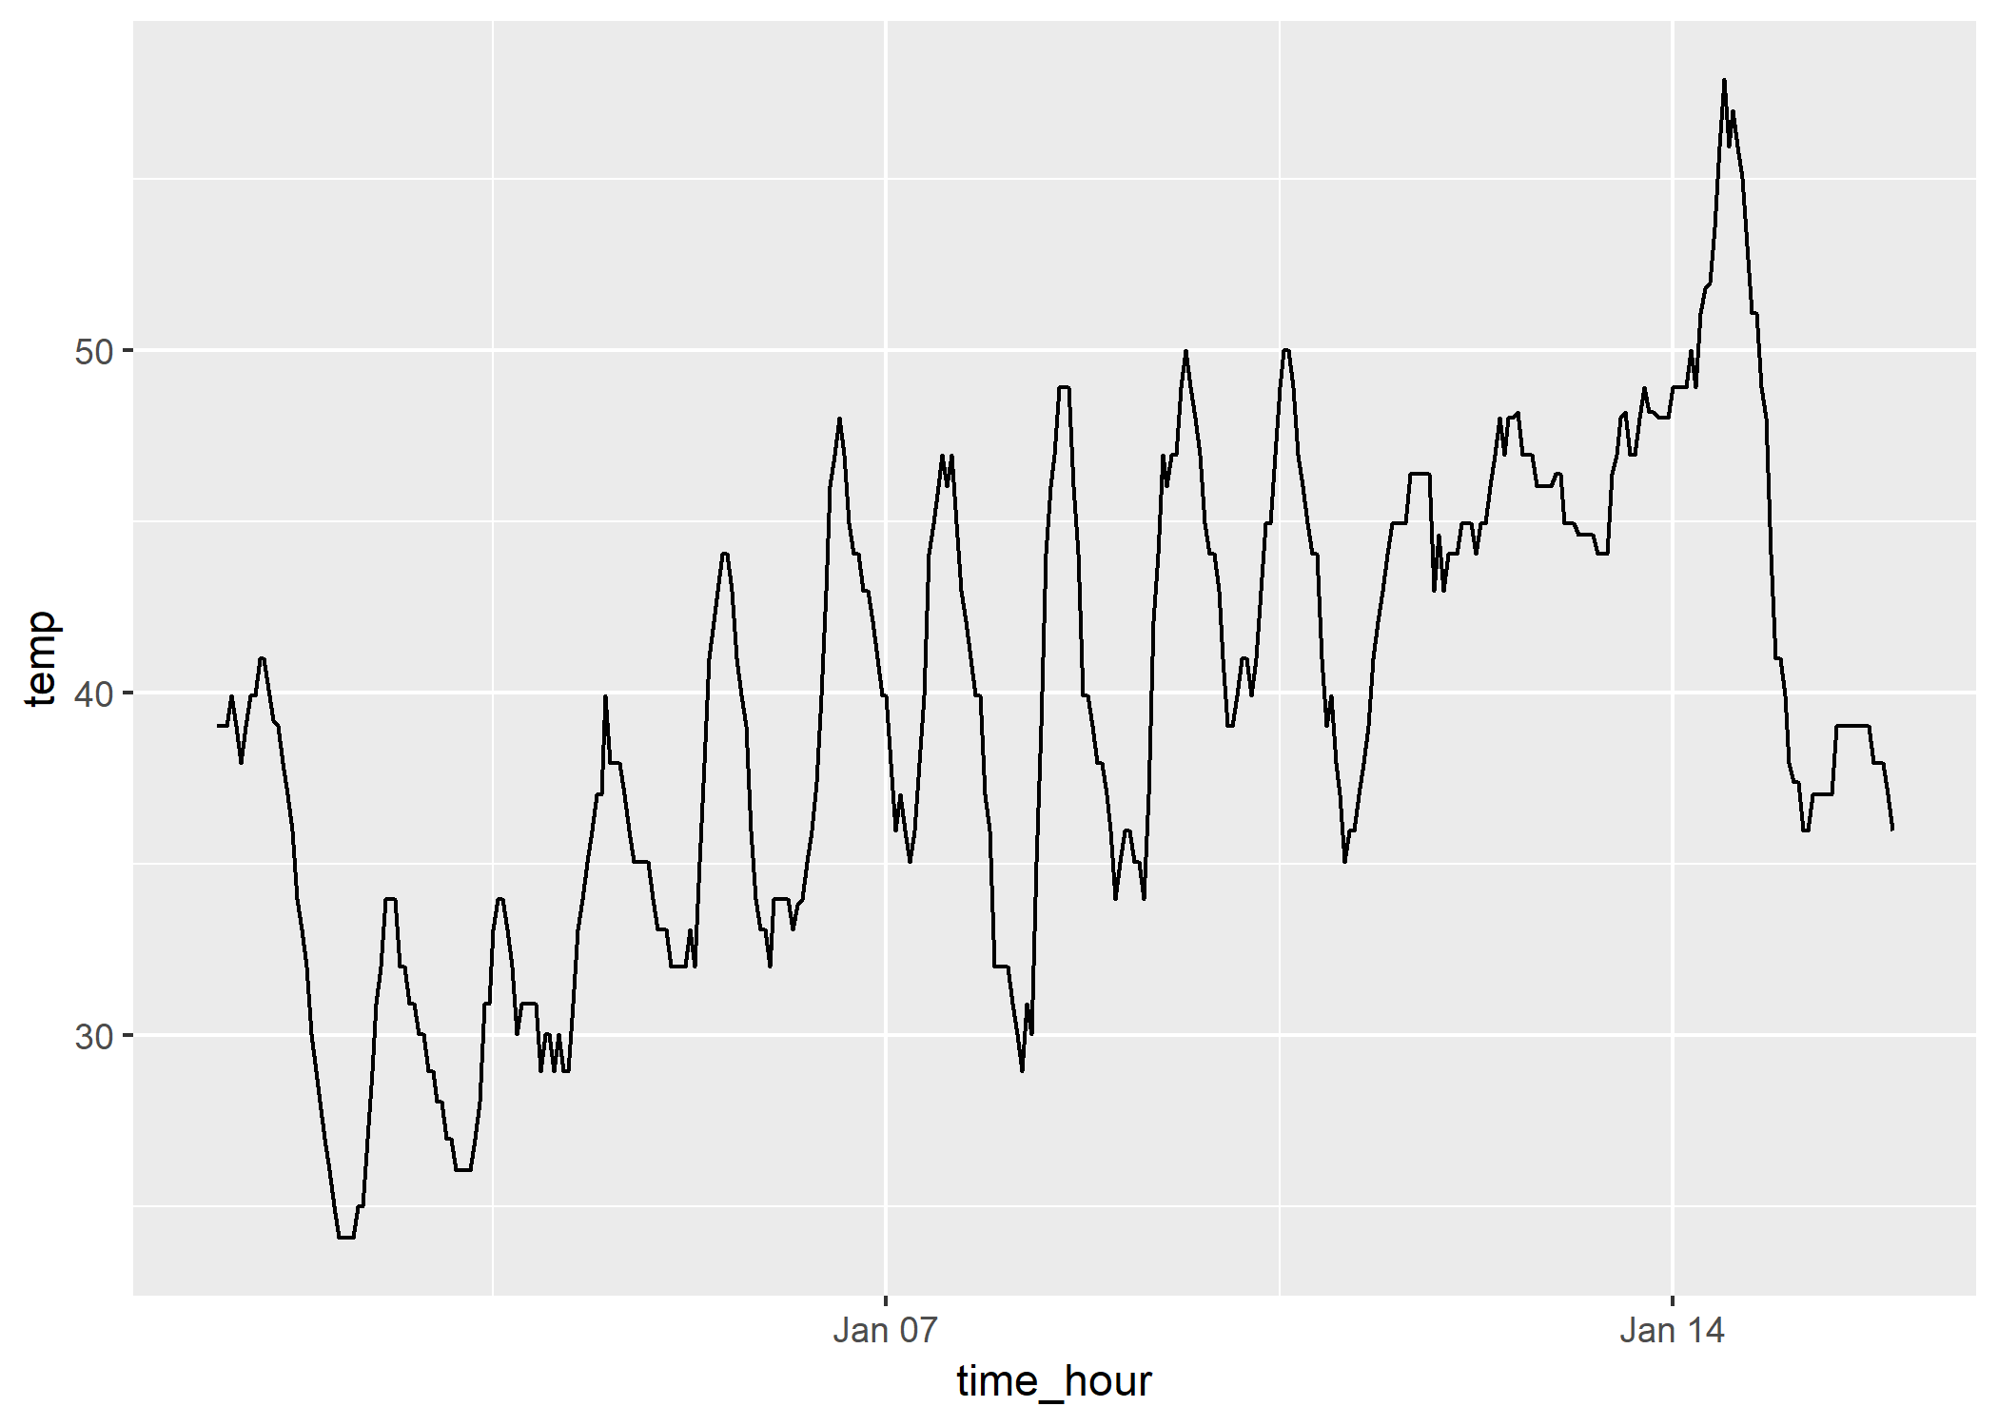
The Line

Slide 12
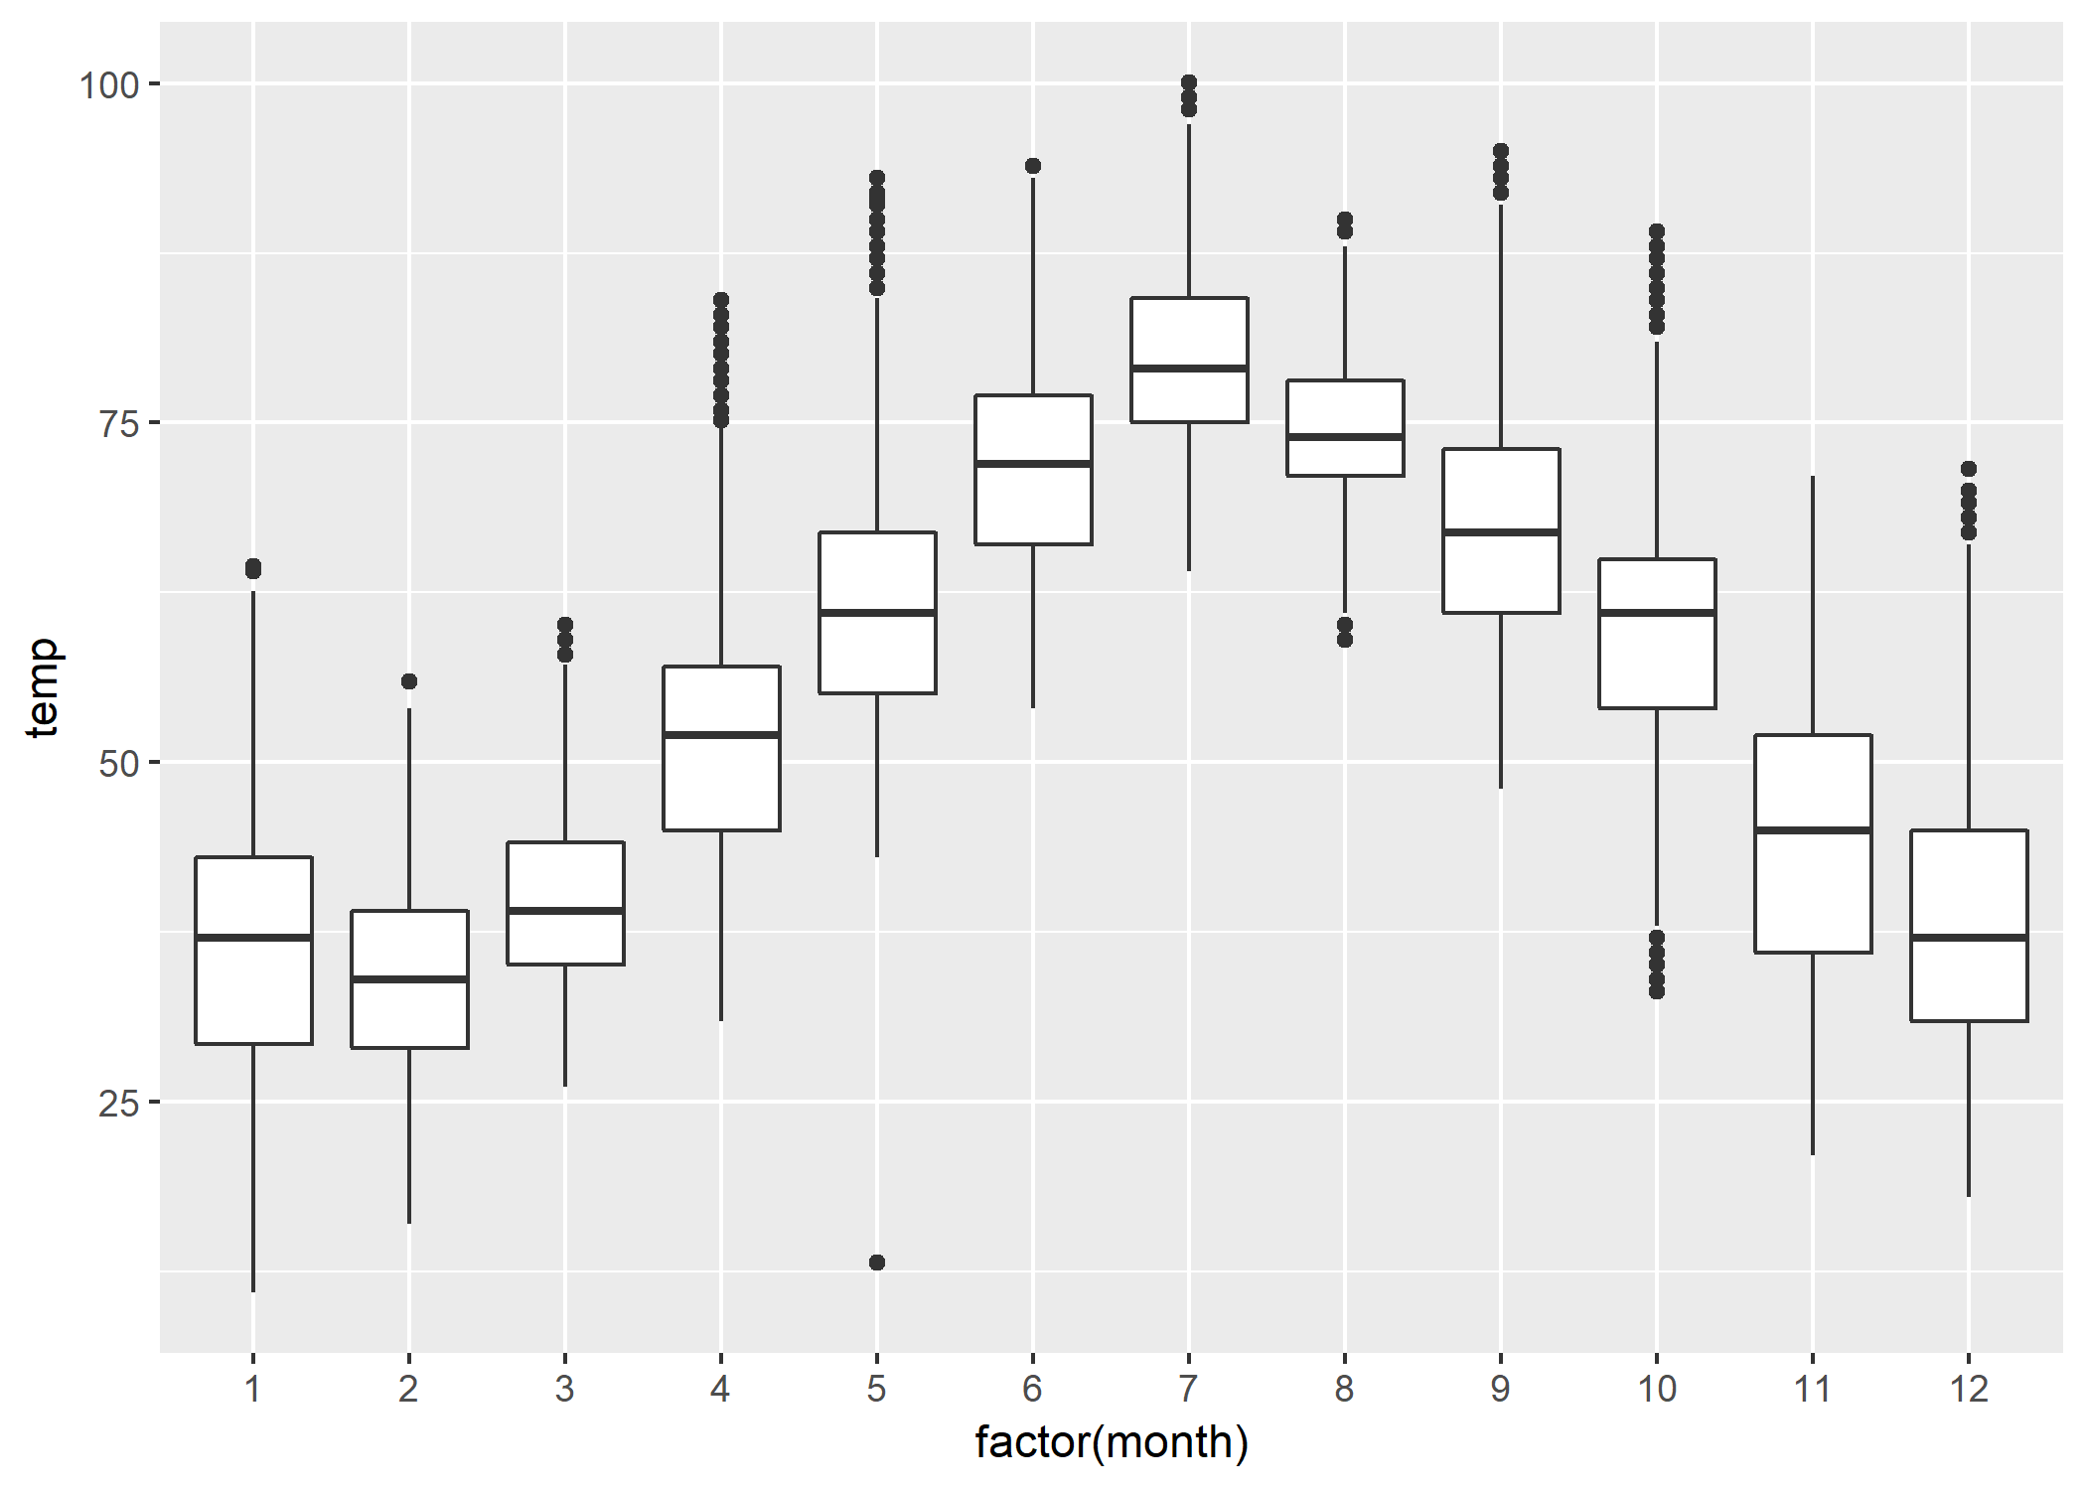
The Box

Slide 13
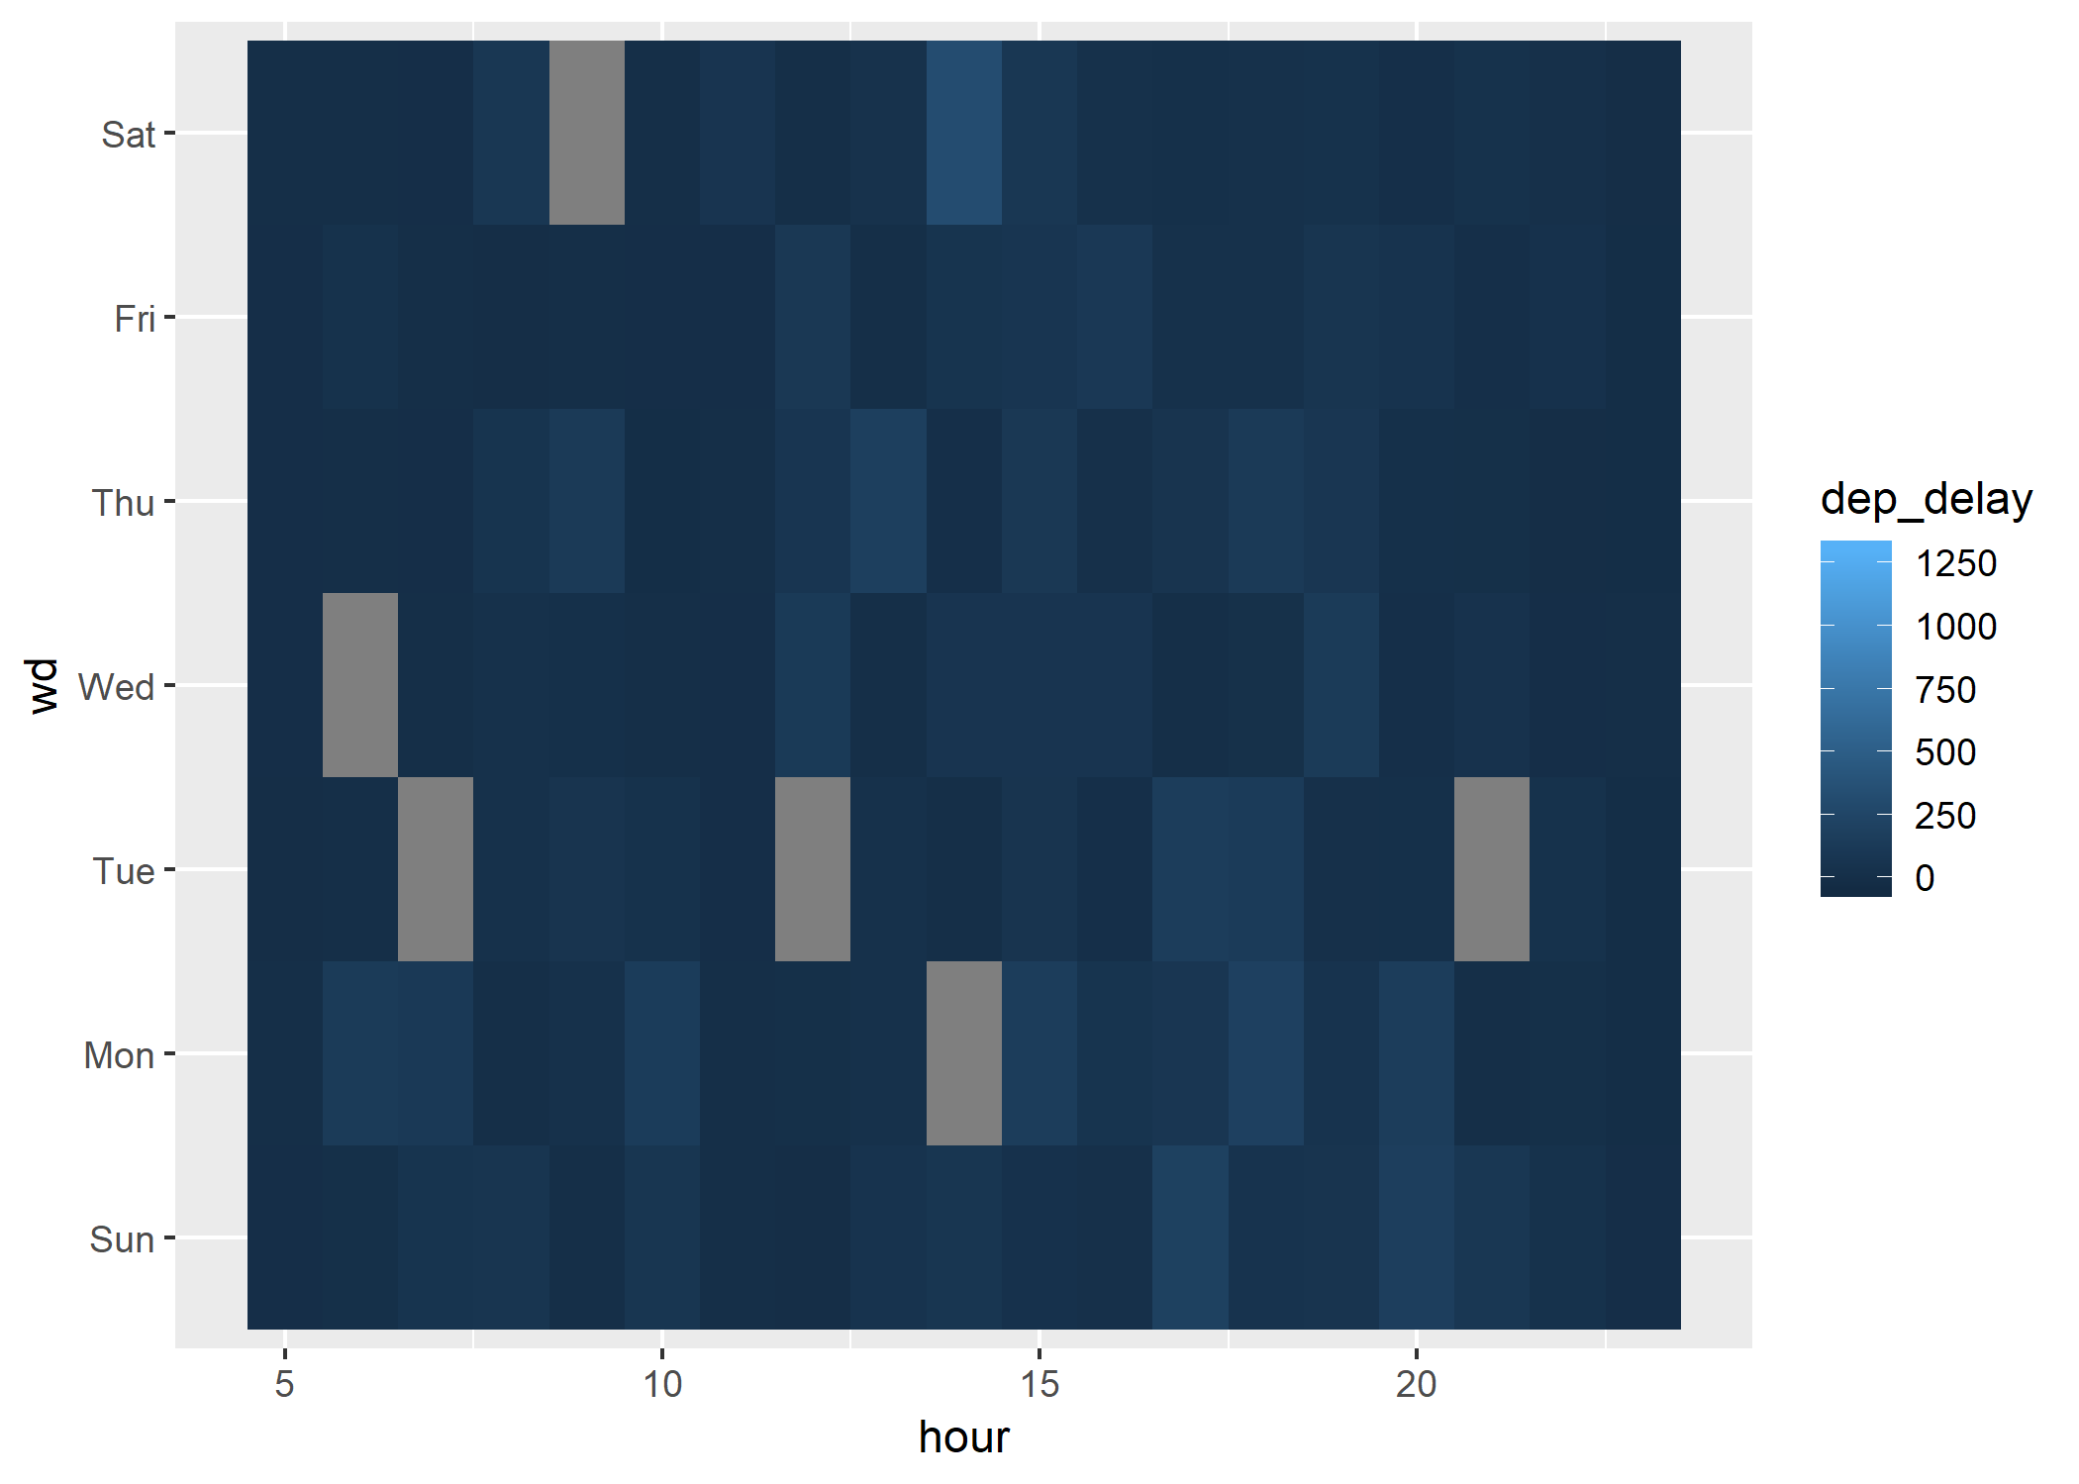
The Heatmap

Slide 14
The Right fit
Combine different plot types can lead to very useful interpretations
Density and Box
Scatter/Point and rug
Box plot plus time series
Additional Considerations
X vs Y / Independent vs Dependent
Faceting
Coloring, grouping, etc

Slide 15
Formatting your Data
Design decisions directly drive formatting of your data
Wide versus long
Mutations and scaling of data
Grouping and faceting
Tidy Data
Naturally works well with the Tidyverse

Slide 16
Formatting your Data
Data.frames/Tibbles
Each row should contain all the information you would want to be plotting for a particular point
Build your pipeline of data manipulation for flexibility

Slide 17
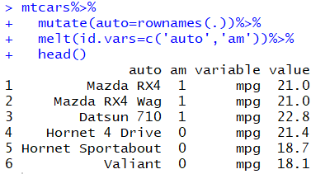
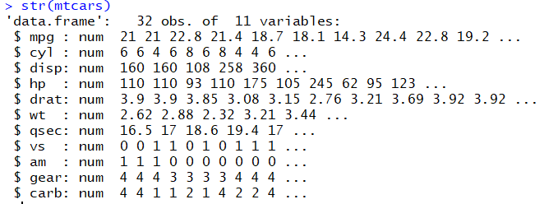
Formatting your Data

Slide 18
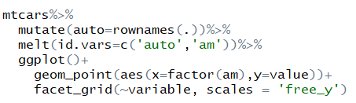
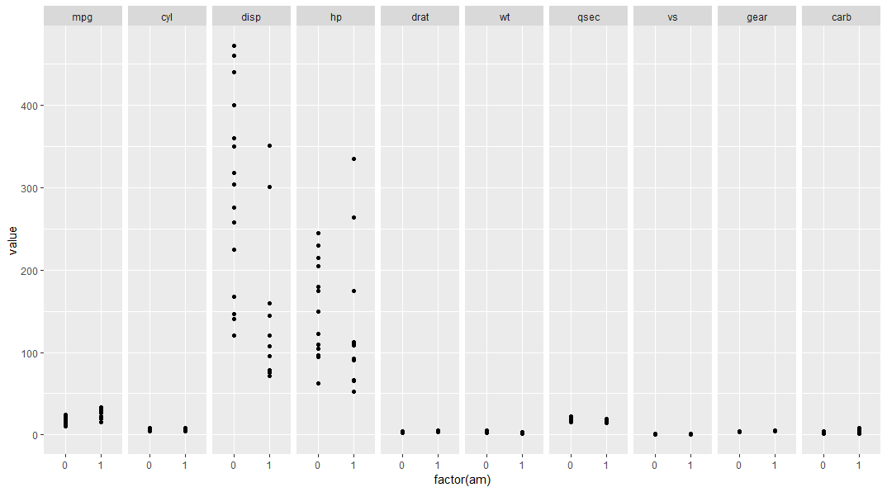
Formatting your Data

Slide 19
Building visualizations in R
We will now use ggplot2 package to build visualizations in R
ggplot- “grammar of graphics”
How it works
Specify plot building blocks and combine them to create just about any kind of graphical display. Building blocks of a graph include:
Data
Aesthetic Mapping
Geometric Object

Slide 20
Ggplot2: aesthetic mapping
In ggplot land, aesthetic means "something you can see". Examples include:
Position (i.e., on the x and y axes)
Color(“outside” color)
Fill(“inside” color)
Shape(of points)
Linetype
size
More info ?aes

Slide 21
Ggplot2: Geometric objects
Geometric objects are the actual marks we put on a plot. Examples include:
points (geom_point, for scatter plots, dot plots, etc),
lines (geom_line, for time series, trend lines, etc),
boxplot (geom_boxplot)
And so much more…
LETS START BUILDING PLOTS!

Slide 22
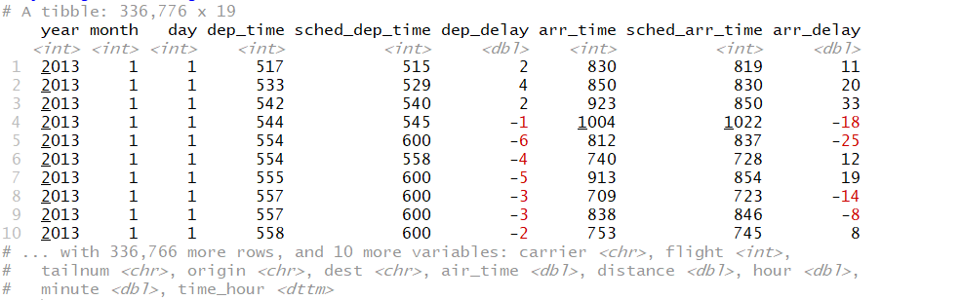
Sample dataset: nycflights13
Airline on-time data for all flights departing NYC in 2013.
Also includes useful 'metadata' on airlines, airports, weather, and planes

Slide 23
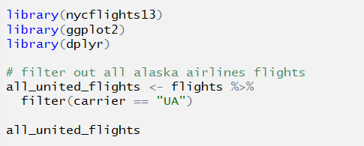
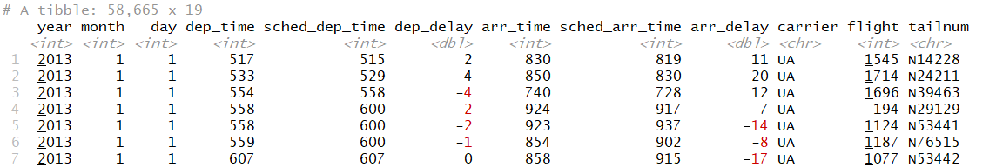
scatterplot
Initial data prep:

Slide 24
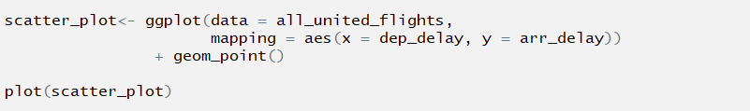
scatterplot
Now we will use scatterplot to identify any relationship between arrival and departure delays of United Airlines flights.

Slide 25
scatterplot
Within the ggplot() function call, we specify two of the components of the grammar:
The data frame to be all_alaska_flights by setting data = all_alaska_flights
Aesthetic mapping by setting aes(x = dep_delay, y = arr_delay)
We add a layer to the ggplot() function call using the + sign. The layer in question specifies the third component of the grammar: the geometric object. In this case the geometric object are points, set by specifying geom_point().

Slide 26
scatterplot
Some notes on layers:
The + sign comes at the end of lines, and not at the beginning. You'll get an error in R if you put it at the beginning.
When adding layers to a plot, you are encouraged to hit Return on your keyboard after entering the + so that the code for each layer is on a new line. As we add more and more layers to plots, you'll see this will greatly improve the legibility of your code.

Slide 27
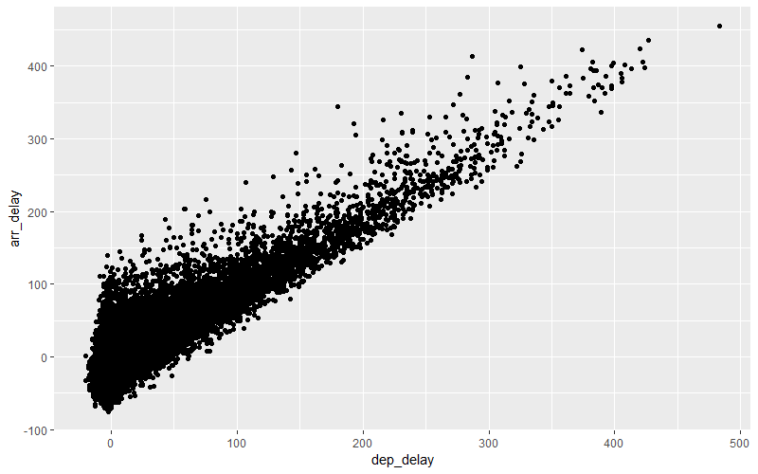
scatterplot

Slide 28
scatterplot
Do you see any overplotting?
The first way of relieving overplotting is by changing the alpha argument in geom_point() which controls the transparency of the points. By default, this value is set to 1. We can change this to any value between 0 and 1 where 0 sets the points to be 100% transparent and 1 sets the points to be 100% opaque.

Slide 29
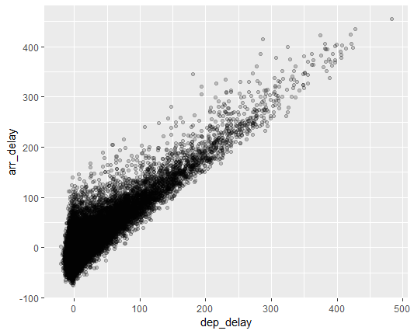
scatterplot

Slide 30
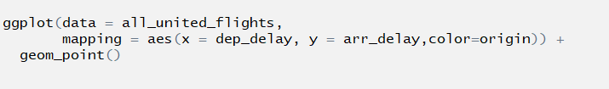
scatterplot
Another popular method is to add a color component. In the given dataset, we can use the origin airports as a differentiating dimension for color to add to the scatterplot.

Slide 31
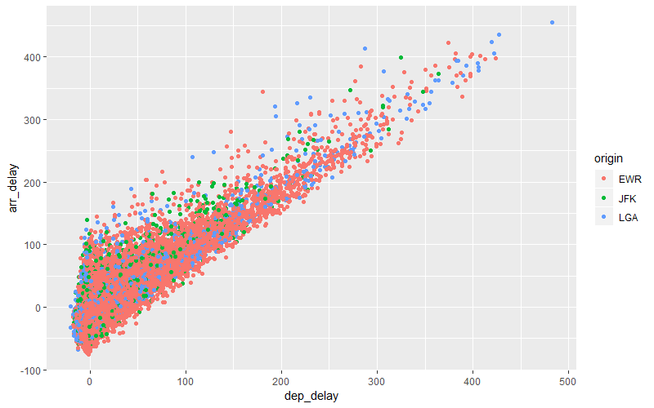
scatterplot

Slide 32
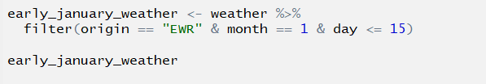
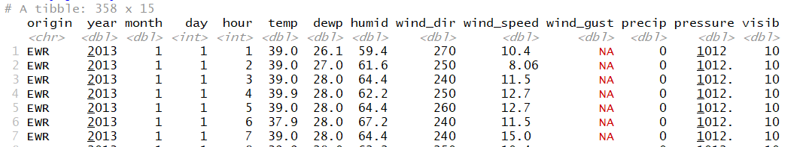
Line chart
Lets plot a line chart to understand variations in early January weather(first 15 days) at the Newark airport.
First we need to do some data prep for the graphic, as usual:

Slide 33

Line chart
Here is how the ggplot command would look like:

Slide 34
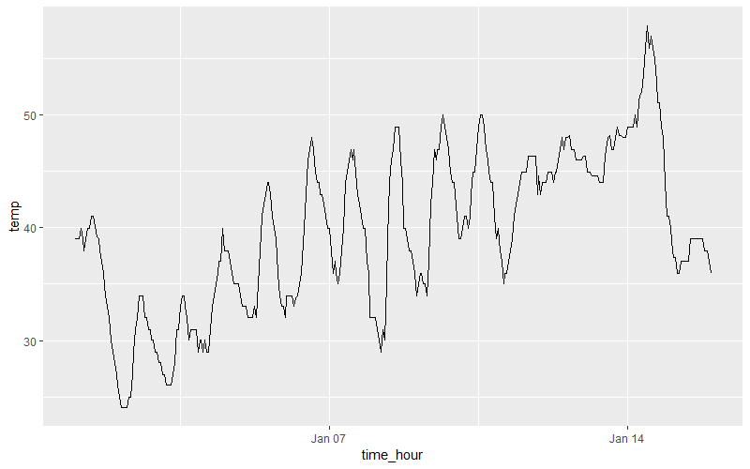
Line chart

Slide 35
Line chart
Sound Check:
What other modifications we can apply to this basic line chart?
What grammar component will be used for each?

Slide 36

Box plot
Lets use ggplo2 to create a box plot of temperature variations over the year.

Slide 37
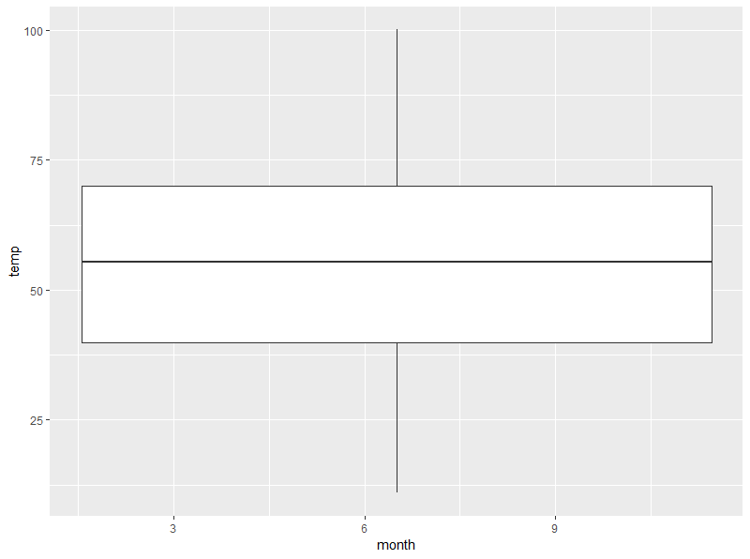
Box plot

Slide 38

Box plot
we are plotting a numerical, and not categorical variable, on the x-axis. This gives us the overall boxplot without any other groupings. We can get around this by introducing a new function for our x variable:

Slide 39
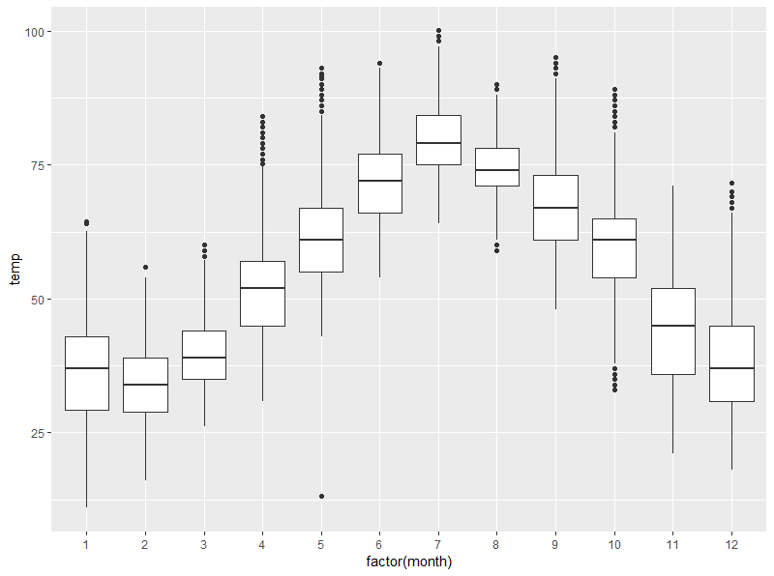
Box plot

Slide 40

Bar chart
Next we will plot a bar graph to compare number of flights from each airline at the New York airports.

Slide 41
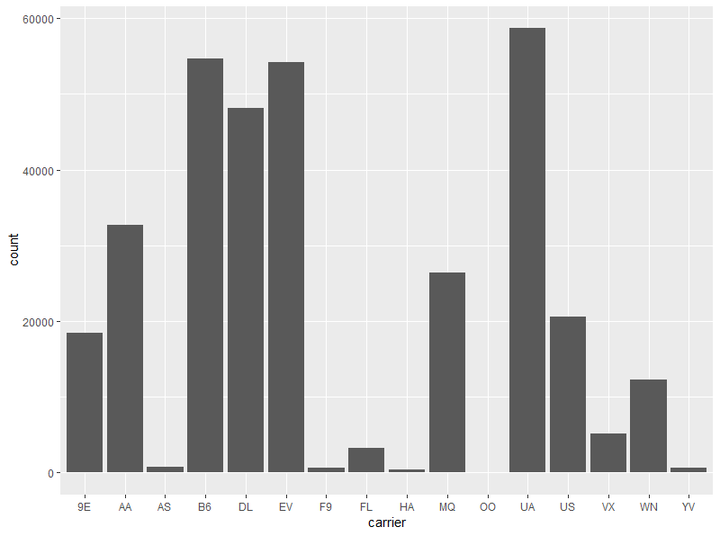
Bar chart

Slide 42

Bar chart
We can use bar charts to compare two categorical variables, this variation is called a stacked bar chart.
minimal data prep:

Slide 43

Bar chart
ggplot2 for stacked bar chart:

Slide 44
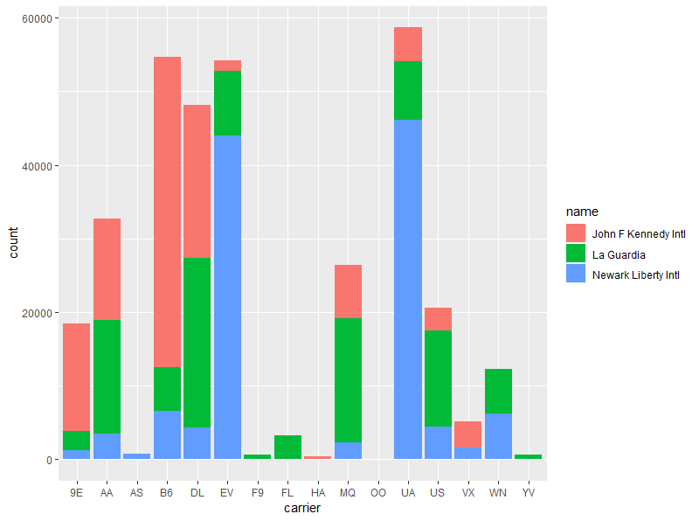
Bar chart

Slide 45

Bar chart
Another variation on the stacked bar chart is the side-by-side bar chart also called a dodged bar chart.

Slide 46
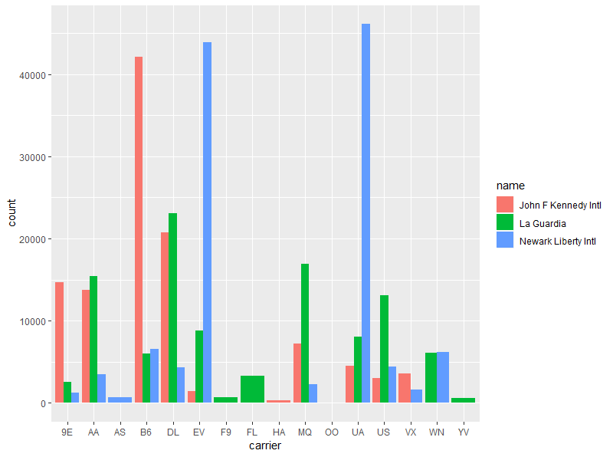
Bar chart

Slide 47
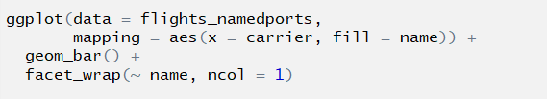
Bar chart
We can also create a faceted bar chart, which creates separate bar plot for a categorical variable and creates a view to assist in comparing values for a common variable.

Slide 48
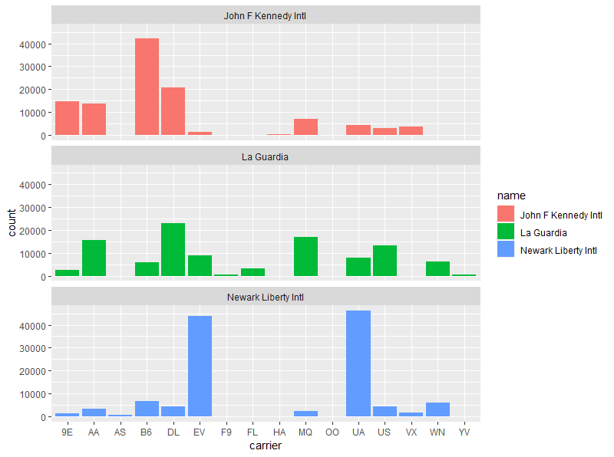
Bar chart

Slide 49
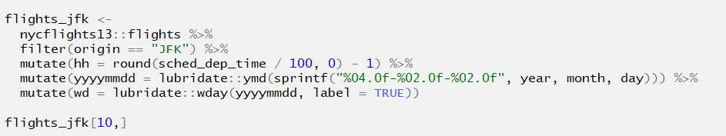
Heat map
We will build a heatmap for plotting departure delays for all days of the week at the JFK airport. We will use the color aspect of the heat map to compare delays for all hours of each day of the week. It sounds intense, but we can achieve it easily through a heat map.
Lets do the data preparation first:

Slide 50

Heat map
Here is the code for building the required heat map:

Slide 51
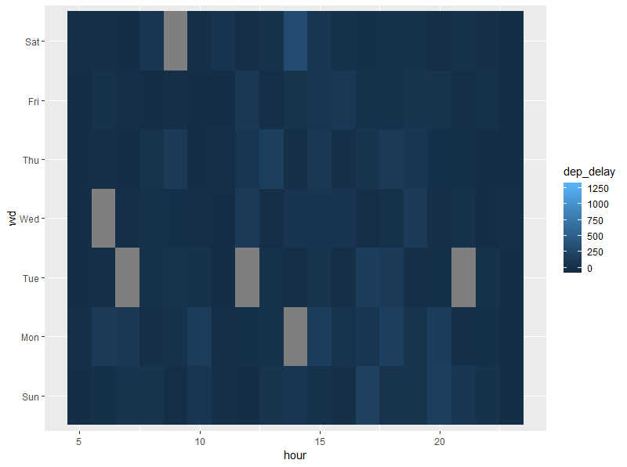
Heat map

Slide 52
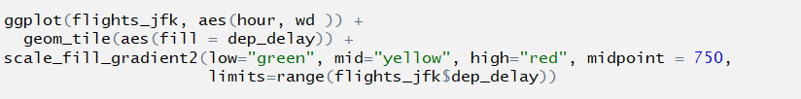
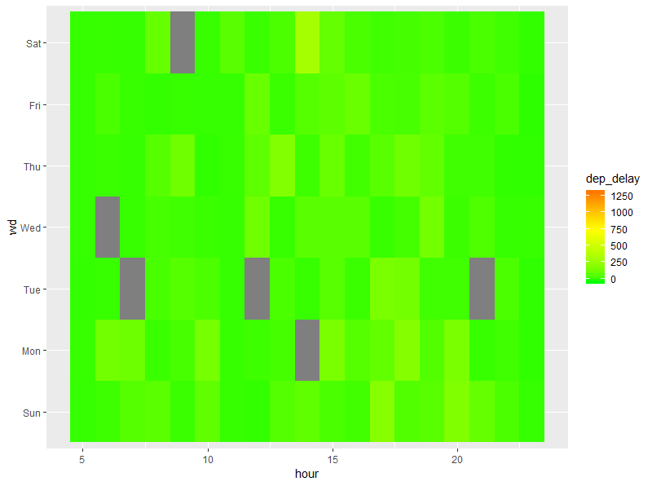
Heat map

Slide 53
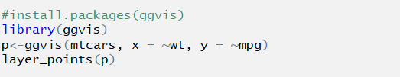
What are my other options?
ggvis
The goal of ggvis is to make it easy to build interactive graphics for exploratory data analysis. ggvis has a similar underlying theory to ggplot2 (the grammar of graphics), but it's expressed a little differently, and adds new features to make your plots interactive. ggvis also incorporates shiny's reactive programming model and dplyr's grammar of data transformation.

Slide 54
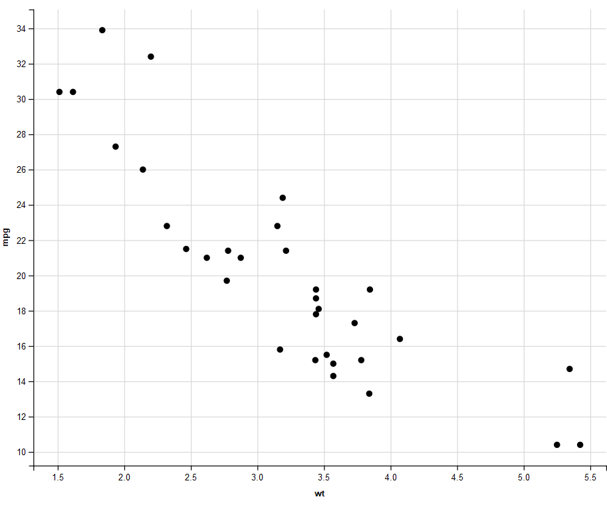
What are my other options?

Slide 55

What are my other options?
all ggvis graphics are web graphics, and need to be shown in the browser. RStudio includes a built-in browser so it can show you the plots directly
add more variables using fill, stroke, size, shape

Slide 56
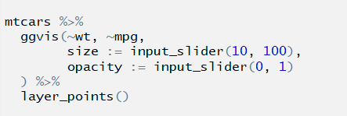
What are my other options?
Add interactive controls:

Slide 57
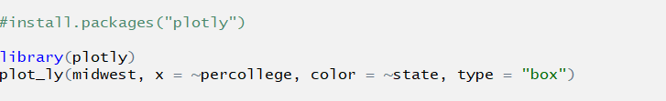
What are my other options?
Plotly
Plotly is an R package for creating interactive web-based graphs via the open source JavaScript graphing library plotly.js.
Plotly graphs are interactive.
You can publish your charts to the web with Plotly's web service.

Slide 58
What are my other options?
Shiny
Shiny is an R package that makes it easy to build interactive web apps straight from R. You can host standalone apps on a webpage or embed them in R Markdown documents or build dashboards. You can also extend your Shiny apps with CSS themes, htmlwidgets, and JavaScript actions.
Shiny applications have two components, a user interface object and a server function, that are passed as arguments to the shinyApp function that creates a Shiny app object from this UI/server pair.

Slide 59
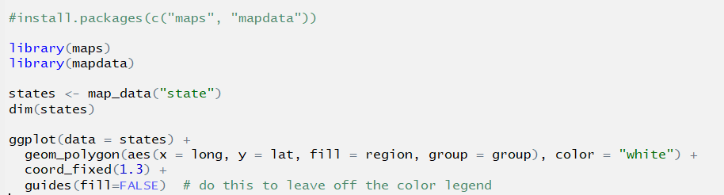
Making maps: a primer
We will look at examples using maps package

Slide 60
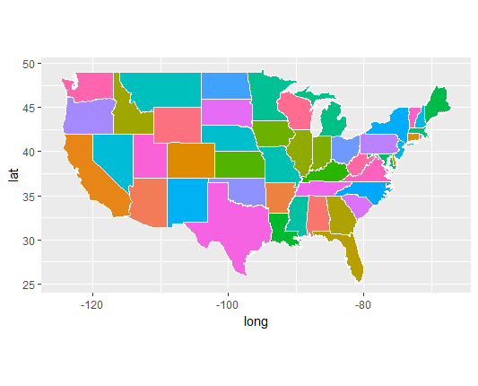
Making maps: a primer

Slide 61
Questions?

